Slide 1

Fundamentals of
Electric Circuit
2020.4
Chapter 5
The Operational Amplifier

Slide 2
Chapter 5 The Operational Amplifier
5.1 Introduction
5.2 The Operational Amplifier
5.3 Ideal Operational Amplifier
5.4 Inverting Amplifier
5.5 Noninverting Amplifier
5.6 The Summing-amplifier (Summer, Adder)
5.7 Difference Amplifier
5.8 Cascaded Op Amp Circuits

Slide 3
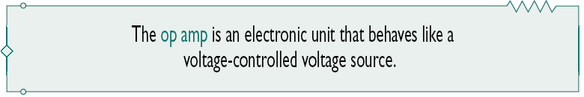
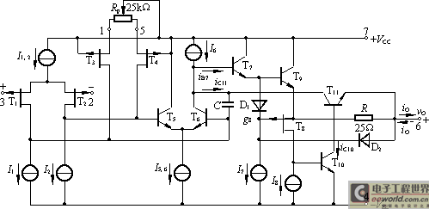
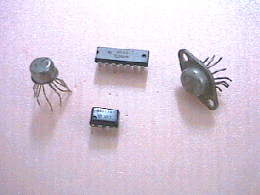
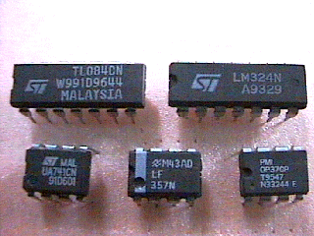
5.1 Introduction
In this chapter, we will study an active circuit element: the operational amplifier, or op amp for short.
Some types of operational amplifiers

Slide 4
5.1 Introduction
Chapter objectives
Master two basic rules that must be applied when analyzing ideal op amp circuits.
Be able to analyze simple circuits containing ideal op amp, and recognize the following op amplifier circuits:
  inverting and noninverting amplifiers,
  adder, subtracter,
  integrator, differentiator, voltage follower.

Slide 5
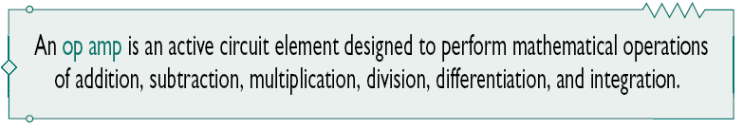
5.2 The Operational Amplifier
An operational amplifier is designed to perform some mathematical operations with external components, such as resistors and capacitors.
In the circuit analysis, we are only concerned with the voltage and current relationships existing between the input and output terminals.

Slide 6
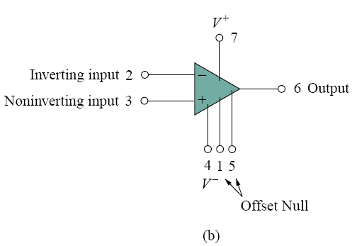
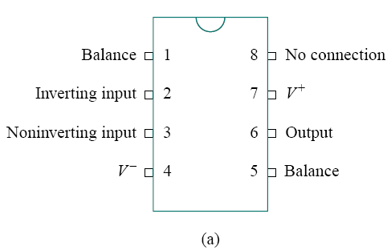
5.2 The Operational Amplifier
1. The inverting input, pin 2.
2. The noninverting input, pin 3.
3. The output, pin 6.
4. The positive power supply V +, pin 7.
5. The negative power supply V −, pin 4.
Figure 5.2 A typical op amp: (a) pin configuration, (b) circuit symbol.

Slide 7

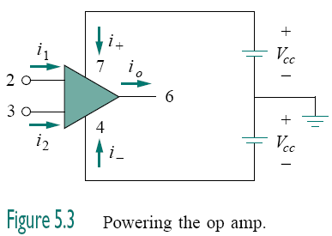
5.2 The Operational Amplifier
As an active element, the op amp must be powered by a voltage supply as typically shown in Fig. 5.3.
By KCL,

Slide 8

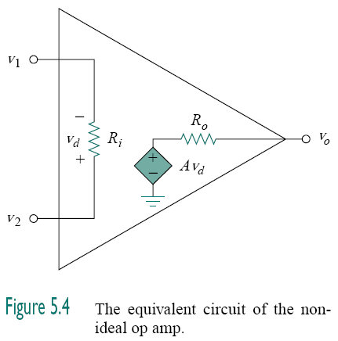
5.2 The Operational Amplifier
The output section consists of a voltage-controlled source in series with the output resistance R_{o}.
The input section consists of a input resistance R_{i}
The differential input voltage v_{d} is given by

Slide 9

Thus, the output v_{o} is given by
A is called the open-loop voltage gain because it is the gain of
the op amp without any external feedback from output to input.

Slide 10


5.3. The ideal op amp
Ideal conditions
Infinite open-loop gain, A≈∞
Infinite input resistance, R_{i} ≈∞
Zero output resistance, R_{o}≈0

Slide 11
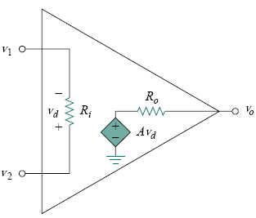
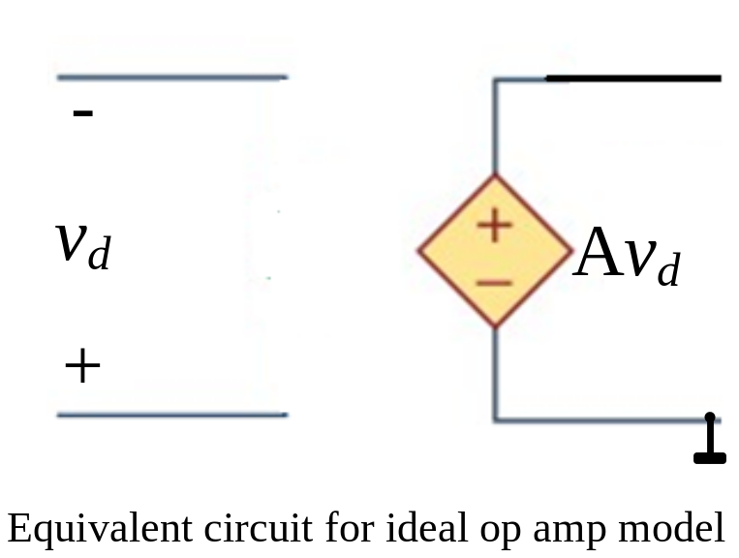
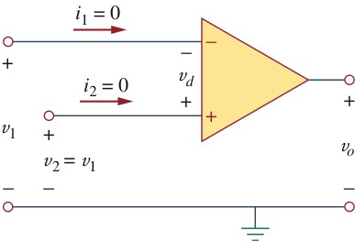
5.3. The ideal op amp
Ideal conditions
Infinite open-loop gain, A≈∞
Infinite input resistance, R_{i} ≈∞
Zero output resistance, R_{o}≈0
Ideal op amp model

Slide 12
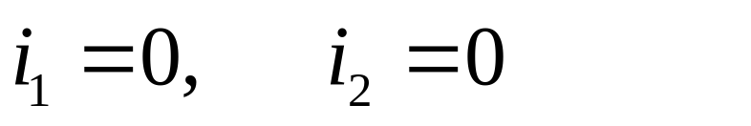
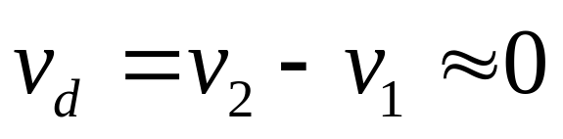
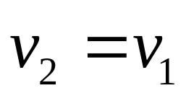
Two important characteristics of the ideal op amp are:
1. The currents into both input terminals are zero:
(virtual open)
2. The voltage across the input terminals is negligibly small; i.e.,
or
(virtual short)
The virtual short and virtual open are extremely important and should be regarded as the key handles to analyzing op amp circuits

Slide 13
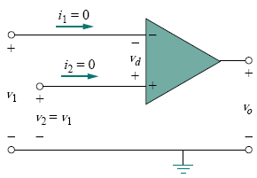



Slide 14

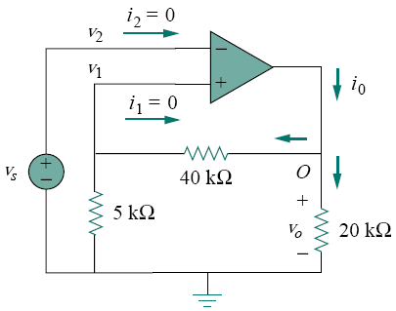







If the ideal op amp is used in the circuit, calculate the closed-loop gain v_{o}/v_{s} , Find i_{o} when v_{s} = 1 V.

Slide 15
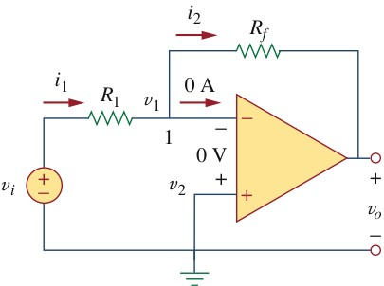
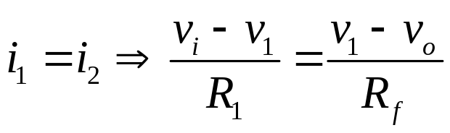
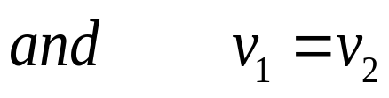

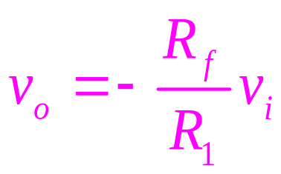
5.4 Inverting Amplifier
The inverting amplifier is shown in the below Figure.
Notice: both the input signal and the feedback are applied at the inverting terminal of the op amp
Hence, we obtain

Slide 16
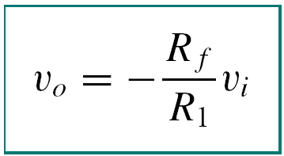
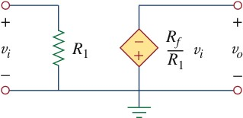
An inverting amplifier reverses the polarity of the input signal while amplifying it.

Slide 17

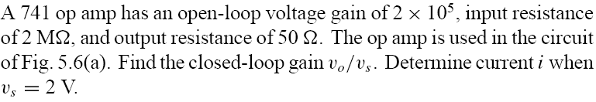
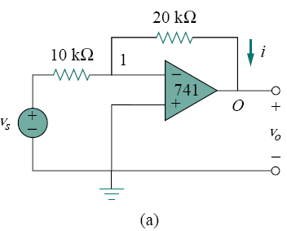
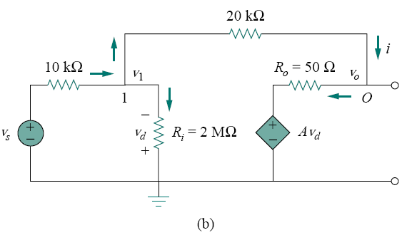




Slide 18

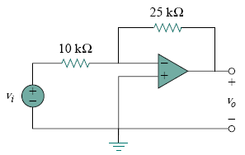




Slide 19
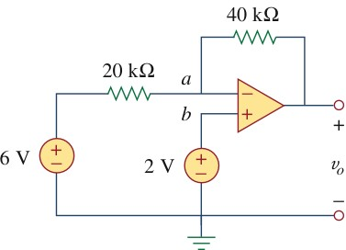
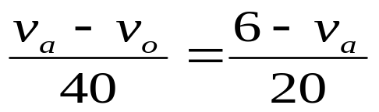
Example 5.4
Determine the v_{o} in the op amp circuit shown in Fig.5.14
Solution:
Applying KCL at node a

Slide 20
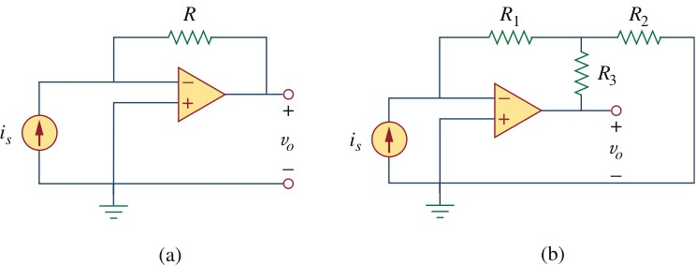
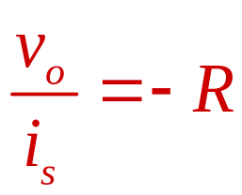
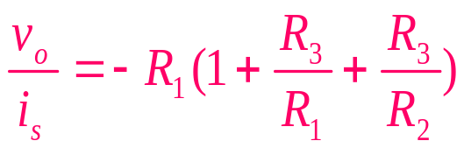
Practice Problem
Two kinds of current-to-voltage converters (also known as transresistance amplifier) are shown in Fig. 5.2
Fig. 5.2

Slide 21
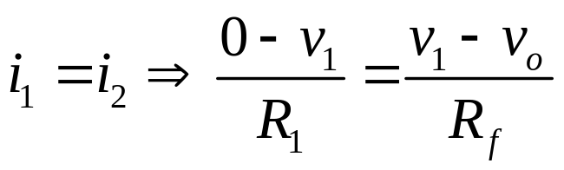
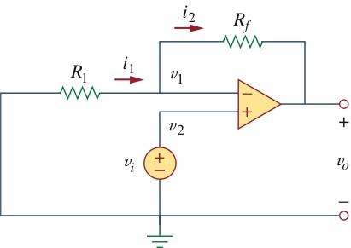
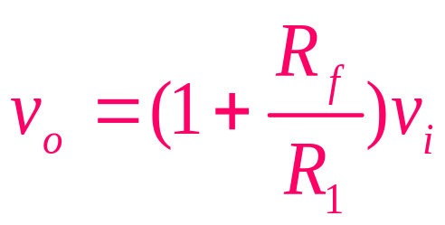
5.5 Noninverting Amplifier
applying KCL at the inverting terminal gives
v₁=v₂=v_{i}
Hence, we obtain
Fig.5.16

Slide 22
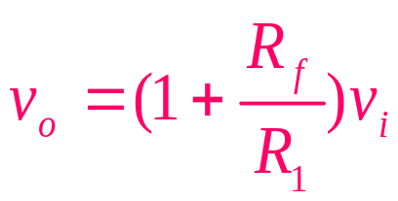
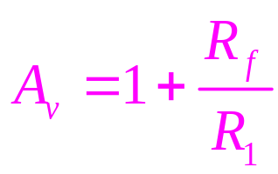

The voltage gain is
A noninverting amplifier is an op amp circuit designed to provide a positive voltage gain
Voltage Follower
If R_{f}=0 or R₁=∞, the noninverting amplifier becomes into unity gain amplifier, which is called a voltage follower because the output follows the input.

Slide 23
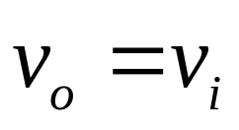
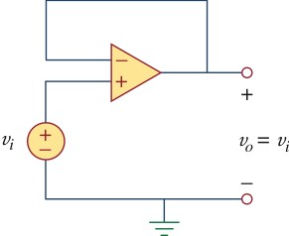
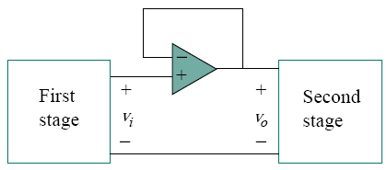
Thus, for a voltage follower
R_{f}=0 , R₁=∞
The voltage follower has very high input impedance and is therefore useful as an intermediate-stage (or buffer) amplifier to isolate one circuit from another, as portrayed in Fig.5.18.
The voltage follower minimizes interaction between the two stages and eliminates inter-stage loading.
Fig.5.18 A voltage follower used to isolate
two cascaded stages of a circuit

Slide 24
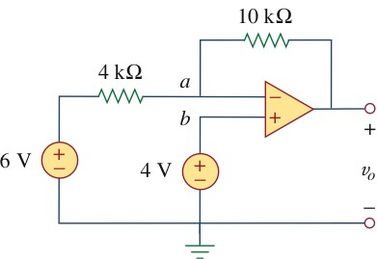



Example 5.5
For the right op amp circuit , calculate the output voltage v_{o}.
Method 1 Applying KCL at node a

Slide 25


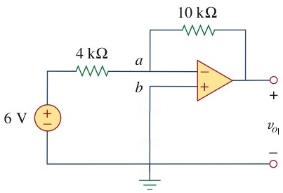
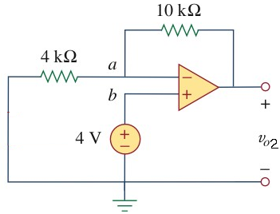


Example 5.5
For the right op amp circuit , calculate the output voltage v_{o}.
Method 2 Using superposition principle

Slide 26
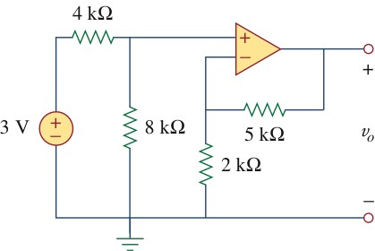
Practice Problem 5.5
Calculate v_{o}in the Fig.5.20
Answer: 7V
Fig.5.20

Slide 27
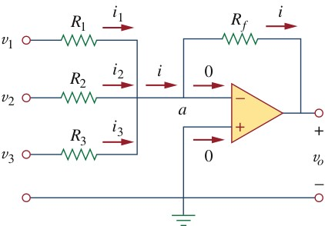
5.4 The Summing-amplifier (Summer, Adder)
The summing amplifier, shown in Fig.5.21, is a variation of the inverting amplifier. It takes advantage of the fact the inverting configuration can handle many inputs at the same time.
Fig.5.21 The summing amplifier

Slide 28
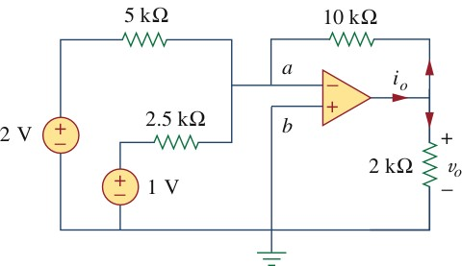
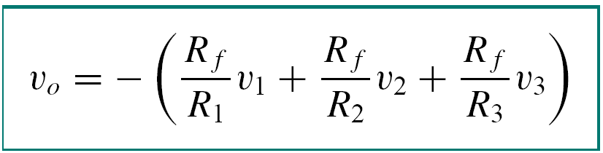
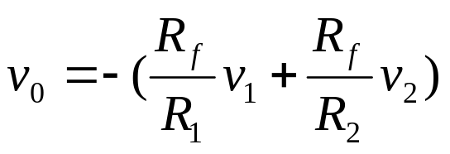



Example 5.6 Calculate v_{o} and i_{o} in the circuit.
This is a summer with two inputs.
The current i_{o} is the sum of the currents through the 10-kΏ and 2-kΏ

Slide 29
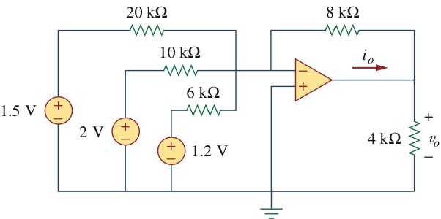
Practice Problem Find v_{o} and i_{o} in the circuit in Fig.5.10.
Fig.5.10
Answer: -3.8V, -1.425mA

Slide 30
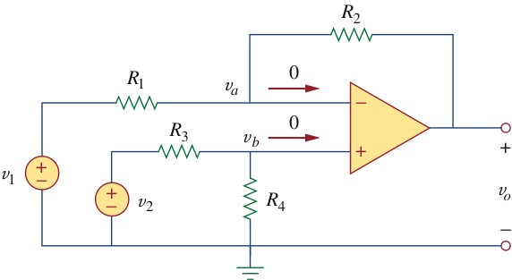








5.5 Difference Amplifier
Applying KCL to node a,
Applying KCL to node b
A difference amplifier is a device that amplified the difference between two inputs but rejects any signals common to the two inputs.
When
Subtractor:
Furthermore, if

Slide 31







Example 5.7
An instrumentation amplifier shows in Fig.5.26 is an amplifier of low-level signal used in process control or measurement applications.
Fig. 5.26

Slide 32


5.6 Cascaded Op Amp Circuits
A cascade connection is a head-to- tail arrangement of two or more op amp circuits such that the output of one is the input of the next.
Fig. 5.13 A three-stage cascaded connection

Slide 33





Slide 34





Slide 35




Slide 36

Example 5
If v₁=1V and v₂=2V find v_{o} in the amp circuit of Fig.5.14
Fig.5.14

Slide 37






Slide 38


5.7 Applications
Digital-to-Analog Converter
The Digital-to-Analog Converter (DAC) transforms digital signals into analog form.
A typical example of a four-bit DAC is illustrated in Fig.5.15(a).
The four-bit DAC can be realized in the binary weighted ladder, shown in Fig.5.15(b).

Slide 39

Digital-to-Analog Converter
The bits are weights according to the magnitude of their place value, by descending value of R_{f}/R_{n} so that each lesser bit has half the weight of the next higher.
The output voltage

Slide 40
The output voltage
Input voltage V₁ is called the most significant bit (MSB), and the input V₄ is the least significant (LSB)
Each of the four binary inputs V₁ ,…, V₄ can assume only two voltage levels: 0 or 1 V.
By using the proper input and feedback resistor values, the DAC provides a single output that is proportional to the inputs.

Slide 41

Example 6
In the op amp circuit of Fig.5.15(b), let R_{f}=10kΩ, R₁=10kΩ, R₂=20kΩ, R₃=40kΩ,and R₄=80kΩ. Find the analog output for binary [0000], [0001], [0010], …, [1111].

Slide 42

Example 6

Slide 43



Slide 44
Summary
There are two fundamental rules that must be applied when analyzing ideal op amp circuits:
  No current ever flows into either input terminal.
  No voltage ever exists between the input terminals.
Op amp circuits are usually analyzed for an output voltage in terms of some input quantity or quantities.

Slide 45
Nodal analysis is typically the best choice in analyzing op amp circuits, and it is usually better to begin at the input, and work toward the output.
The output current of op amp cannot be assumed; it must be found after the output voltage has been determined independently.

Slide 46


